Slide 1
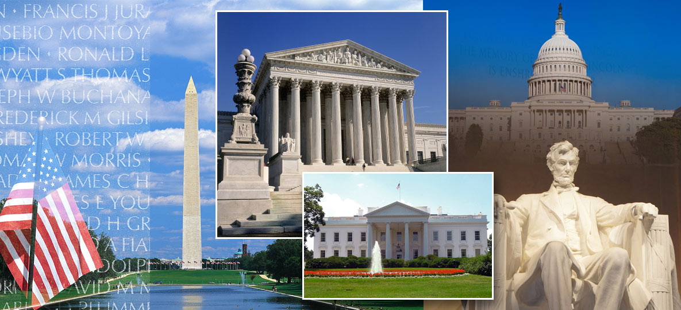
Jennifer Schaus & Associates SERVICES FOR US FEDERAL GOVERNMENT CONTRACTORS WEBINAR WEDNESDAYS – 2018 WASHINGTON, DC OFFICE PHONE: 2 0 2 – 3 6 5 – 0 5 9 8

Slide 2
Jennifer Schaus & Associates – GOV CON WEBINAR SERIES - 2018 - WASHINGTON DC www.JenniferSchaus.com
Join Us for Our 2018 Series of Complimentary Webinars
on various US Federal Government Contracting Topics.
Presenters are industry experts
sharing knowledge
about the competitive government contracting sector.
Find all of our Govt Contracting webinars (free download) at www.JenniferSchaus.com
Contact Us @ 2 0 2 – 3 6 5 – 0 5 9 8

Slide 3
Jennifer Schaus & Associates – GOV CON WEBINAR SERIES - 2018 - WASHINGTON DC www.JenniferSchaus.com
REMINDERS:
All webinars are complimentary.
All webinars are recorded.
They are found on our website and on YouTube.
Please send your questions to the speaker directly.
Thank you for participating.

Slide 4
Jennifer Schaus & Associates – GOV CON WEBINAR SERIES - 2018 - WASHINGTON DC www.JenniferSchaus.com
ABOUT JENNIFER SCHAUS & ASSOCIATES:
Based in downtown Washington, DC;
A la carte services for Federal Contractors;
Proposal Writing to GSA Schedules, 8a Cert, Contract Admin & more!;
Educational webinars;
Networking events and seminars;
WEBSITE: http://www.JenniferSchaus.com

Slide 5
Jennifer Schaus & Associates – GOV CON WEBINAR SERIES - 2018 - WASHINGTON DC www.JenniferSchaus.com
In our weekly newsletter
OR
In our 2019 Webinar Wednesday Series
Contact Mallory.Flowers@JenniferSchaus.com for more information

Slide 6
Jennifer Schaus & Associates – GOV CON WEBINAR SERIES - 2018 - WASHINGTON DC www.JenniferSchaus.com
ABOUT OUR SPEAKER:
Mark Amadeo
Over 20 years as government counsel & law firm counsel
LL.M. Georgetown University Law Center; J.D. University of Wisconsin Law School; B.A. Boston College
Founder & Managing Partner of Amadeo Law Firm, PLLC
Focus on Government Contracting & Technology
Review/negotiation: FAR/DFARS compliance
Pre & Post Award Teaming: JV’s & Subcontracts
Technology: IP preservation & commercialization

Slide 7
Jennifer Schaus & Associates – GOV CON WEBINAR SERIES - 2018 - WASHINGTON DC www.JenniferSchaus.com
Understanding GSA’s Price Reduction Clause
Wednesday, December 12, 2018

Slide 8
Jennifer Schaus & Associates – GOV CON WEBINAR SERIES - 2018 - WASHINGTON DC www.JenniferSchaus.com
Understanding GSA’s Price Reduction Clause
Federal Supply Schedule Program
Simplified Process
Commercial Supplies or Services
Volume Prices

Slide 9
Jennifer Schaus & Associates – GOV CON WEBINAR SERIES - 2018 - WASHINGTON DC www.JenniferSchaus.com
Understanding GSA’s Price Reduction Clause
GSA Schedule Contract Process
Prerequisites – 2 Years In Business, DUNS, SAM
Identify Schedule Contract & Solicitation
Proposal or Offer
Price Proposal Template
Labor Matrix (Personnel)
Financial Statements
Subcontracting Plan
Technical Proposal
Professional Compensation Plan
Previous Cancellation/Rejection Letters
EULAS
Commercial Sales Practices (CSP)
Commercial Price List
Pricing Support Documentation
Price Narrative
Contract Officer Review & Price Negotiation
Final Proposal

Slide 10
Jennifer Schaus & Associates – GOV CON WEBINAR SERIES - 2018 - WASHINGTON DC www.JenniferSchaus.com
Understanding GSA’s Price Reduction Clause
Price Reduction Clause
Before Contract Award – CO & Contractor Agree
Basis of Award – Which Customers/Categories
Gov’s Pricing/Discount Relationship With BOA
Customers/Categories
Relationship Maintained For Contract Period – So Tracking Required

Slide 11
Jennifer Schaus & Associates – GOV CON WEBINAR SERIES - 2018 - WASHINGTON DC www.JenniferSchaus.com
Understanding GSA’s Price Reduction Clause
When Is There A Price Reduction?
Any Change In Pricing or Discount Arrangement
To Identified BOA Customers/Categories
Disturbs Gov Price or Discount Relationship

Slide 12
Jennifer Schaus & Associates – GOV CON WEBINAR SERIES - 2018 - WASHINGTON DC www.JenniferSchaus.com
Understanding GSA’s Price Reduction Clause
When Is There A Price Reduction?
BOA Customers – 20% Discount Off Retail Price
GSA – 25% Discount Off Retail Price (5% Relationship)
New Price BOA Customers – 22% Discount Off Retail
GSA – 25% Discount Off Retail Price (3% Relationship)

Slide 13
Jennifer Schaus & Associates – GOV CON WEBINAR SERIES - 2018 - WASHINGTON DC www.JenniferSchaus.com
Understanding GSA’s Price Reduction Clause
What Happens If There Is A Price Reduction?
Contractor Must:
Offer the same price reduction
Same Effective Date
Same Time Period

Slide 14
Jennifer Schaus & Associates – GOV CON WEBINAR SERIES - 2018 - WASHINGTON DC www.JenniferSchaus.com
Understanding GSA’s Price Reduction Clause
What Happens If There Is A Price Reduction?
BOA Customers – 20% Discount Off Retail Price
GSA – 25% Discount Off Retail Price (5% Relationship)
New Price BOA Customers – 22% Discount Off Retail
GSA – 25% Discount Off Retail Price (3% Relationship)
New GSA Price GSA – 27% Discount Off Retail (5% Relationship)

Slide 15
Jennifer Schaus & Associates – GOV CON WEBINAR SERIES - 2018 - WASHINGTON DC www.JenniferSchaus.com
Understanding GSA’s Price Reduction Clause
Exceptions
FFP, DQ Over Max Threshold
Other Fed Agencies
552.238-78 BOA Organizations
Error in Billing or Quotation

Slide 16
Jennifer Schaus & Associates – GOV CON WEBINAR SERIES - 2018 - WASHINGTON DC www.JenniferSchaus.com
Understanding GSA’s Price Reduction Clause
Mandatory Reporting
During Contract Period Must Report To CO
All Price Reductions
To BOA Customers/Categories
Explanation of Conditions
Notification Deadline – ASAP, but no later than 15 calendar days after effective

Slide 17
Jennifer Schaus & Associates – GOV CON WEBINAR SERIES - 2018 - WASHINGTON DC www.JenniferSchaus.com
Understanding GSA’s Price Reduction Clause
Deemed Price Reductions
Revisions to catalog, pricelists, schedules
More favorable discounts or terms/conditions
than in catalog, pricelists, schedules
Special discounts to BOA customers/categories
that disturbs Gov relationship

Slide 18
Jennifer Schaus & Associates – GOV CON WEBINAR SERIES - 2018 - WASHINGTON DC www.JenniferSchaus.com
Understanding GSA’s Price Reduction Clause
Avoiding PRC Triggers
Monitor advertisements/offers
BOA Customer Pricing – Multiple Approvals
Track Sales to BOA Customers
Train Sales Team
Document & Explain Temporary Discounts

Slide 19
Jennifer Schaus & Associates – GOV CON WEBINAR SERIES - 2018 - WASHINGTON DC www.JenniferSchaus.com
Understanding GSA’s Price Reduction Clause
Future of Price Reduction Clause
2016 GSAR Rule
Moving from Vertical to Horizontal Model
Pilot Program
Transactional Data Reporting
No CSP Disclosures
Not Subject to BOA Customer Price Tracking

Slide 20
THANK YOU FOR ATTENDING!! WWW.JENNIFERSCHAUS.COM
QUESTIONS?
CONTACT OUR SPEAKER Mark Amadeo AT (202) 640-2090 AND AT mamadeo@amadeolaw.com
SERVICES FOR US FEDERAL CONTRACTORS OFFICE: 2 0 2 – 3 6 5 – 0 5 9 8

